Slide 1

Bank Credit Card Churn Analysis
Comprehensive analysis of customer attrition patterns and retention strategies for bank credit card portfolio
By: Reaal Salah

Slide 2
Agenda
01
02
03
Dataset Overview
Business Questions
Data Preparation
Understanding our credit card customer base and attrition data
Five critical questions driving our churn analysis
Loading, cleaning, and preparing data for analysis
04
05
Exploratory Analysis
Strategic Recommendations
Deep dive into customer behavior patterns and churn drivers
Actionable retention strategies and implementation roadmap

Slide 3

Dataset Overview
Customer Churn Focus
This comprehensive dataset captures customer behavior patterns across our credit card division, enabling detailed analysis of attrition drivers and retention opportunities.
The data encompasses customer demographics, product usage patterns, and behavioral indicators that signal churn risk.

Slide 4

Key Business Questions
1
2
3
What is the baseline customer churn rate across our credit card portfolio?
How does attrition vary across different customer age demographics?
Which card category shows the highest churn rate and associated percentage?
4
5
Average inactive months comparison between churned and retained customers
Which income category demonstrates the highest churn rate (excluding unknown)?

Slide 5




Data Cleaning Process
Load & Preview
Remove Unnecessary
Rename Columns
Comprehensive data assessment including columns, data types, missing values, and duplicate detection
Eliminate CLIENTNUM and two Naive_Bayes columns that don't contribute to business analysis
Apply business-friendly naming conventions (e.g., Months_on_book → Months as Customer)
Result: Clean, readable, and business-ready dataset optimized for analytical insights

Slide 6
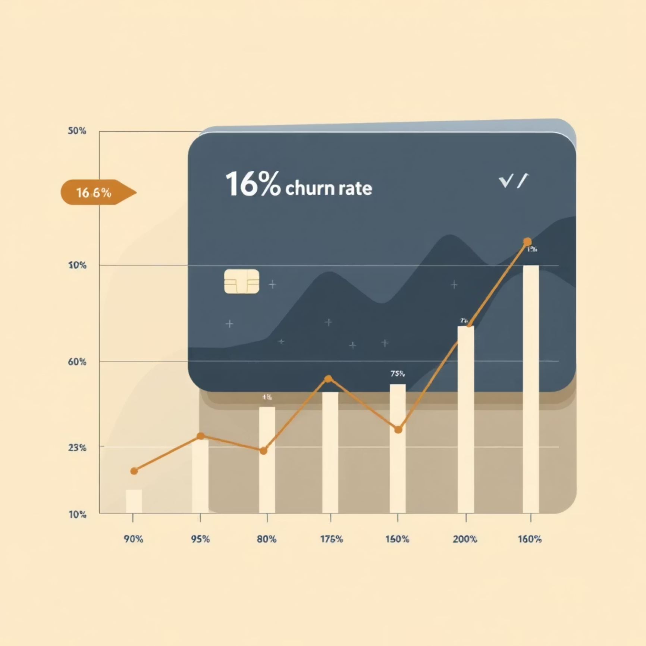
Q1: Overall Customer Attrition Rate
16%
Customer Churn Rate
Baseline attrition across credit card portfolio
Key Insight: Our current churn rate of approximately 16% represents a moderate level of customer attrition. This baseline metric provides a critical benchmark for measuring the effectiveness of future retention initiatives and month-over-month performance comparisons.
This rate aligns with industry standards for credit card portfolios, indicating stable but improvable customer retention performance.

Slide 7
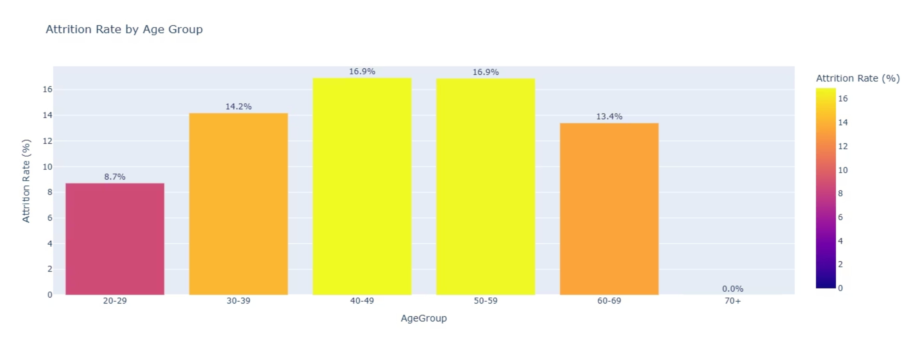
Q2: Attrition Patterns by Age Group
50+ Age Group
Younger Customers
Higher Churn Risk: Customers over 50 demonstrate elevated attrition rates compared to younger demographics
Better Retention: Under-50 customers show stronger loyalty and lower churn probability

Slide 8
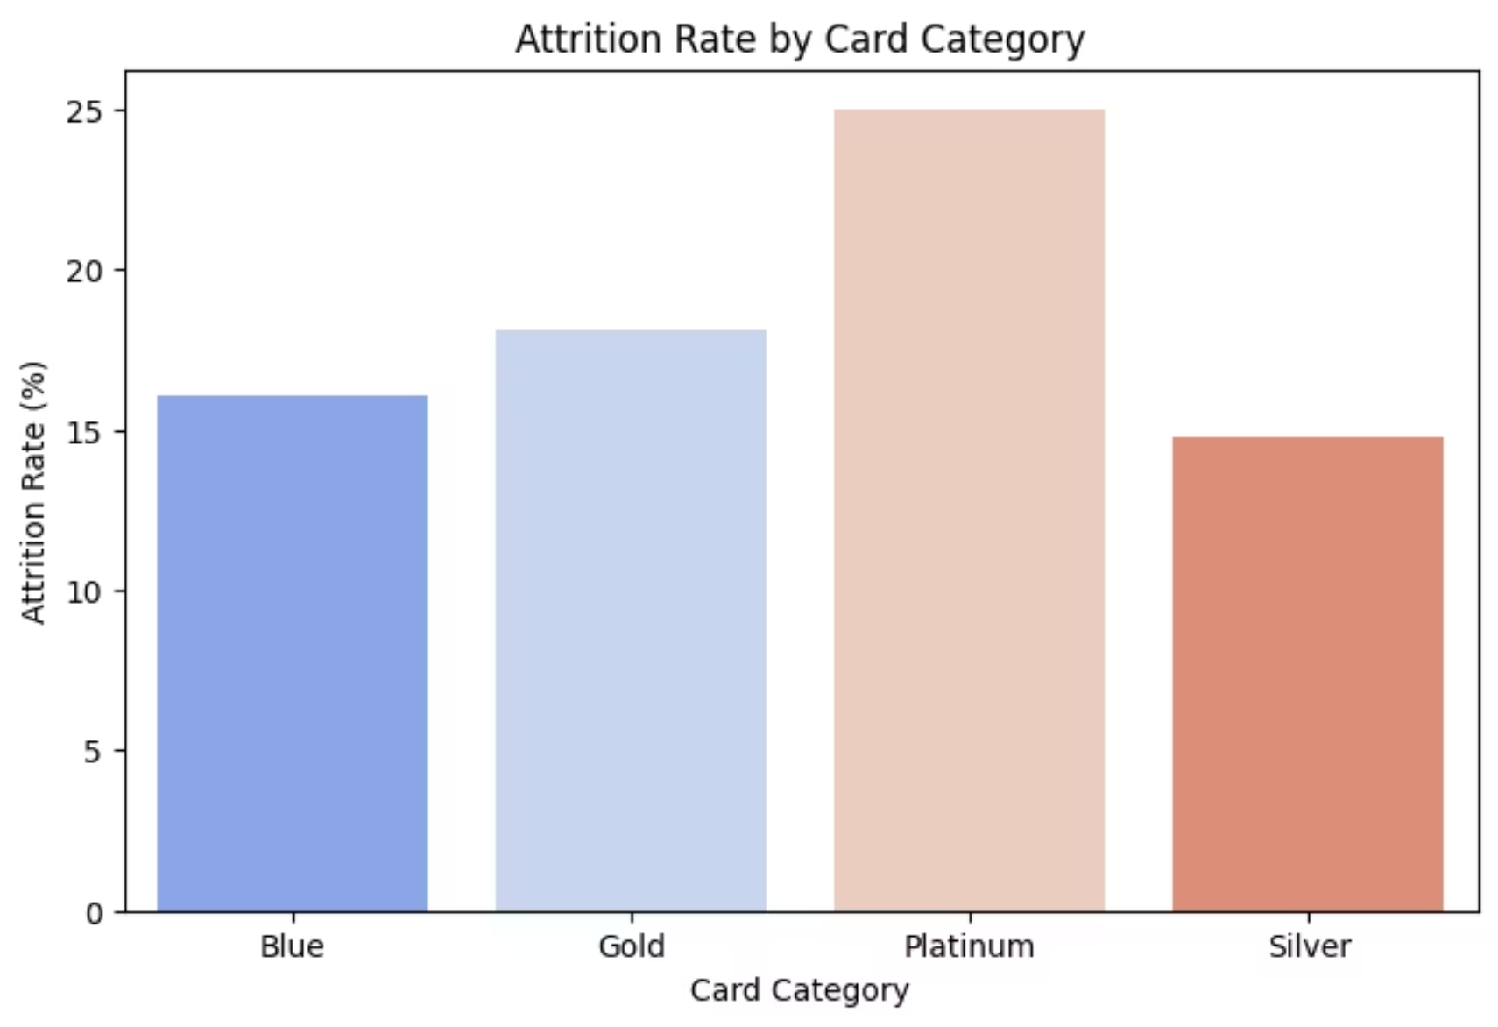
Q3: Card Category Performance Analysis
Blue Card Challenge
Highest Churn: Blue card customers exhibit the highest attrition rate in our portfolio, indicating potential gaps in value proposition for this segment.
Premium Advantage: Gold and Platinum cardholders demonstrate significantly lower churn rates, suggesting premium benefits effectively drive customer loyalty.

Slide 9
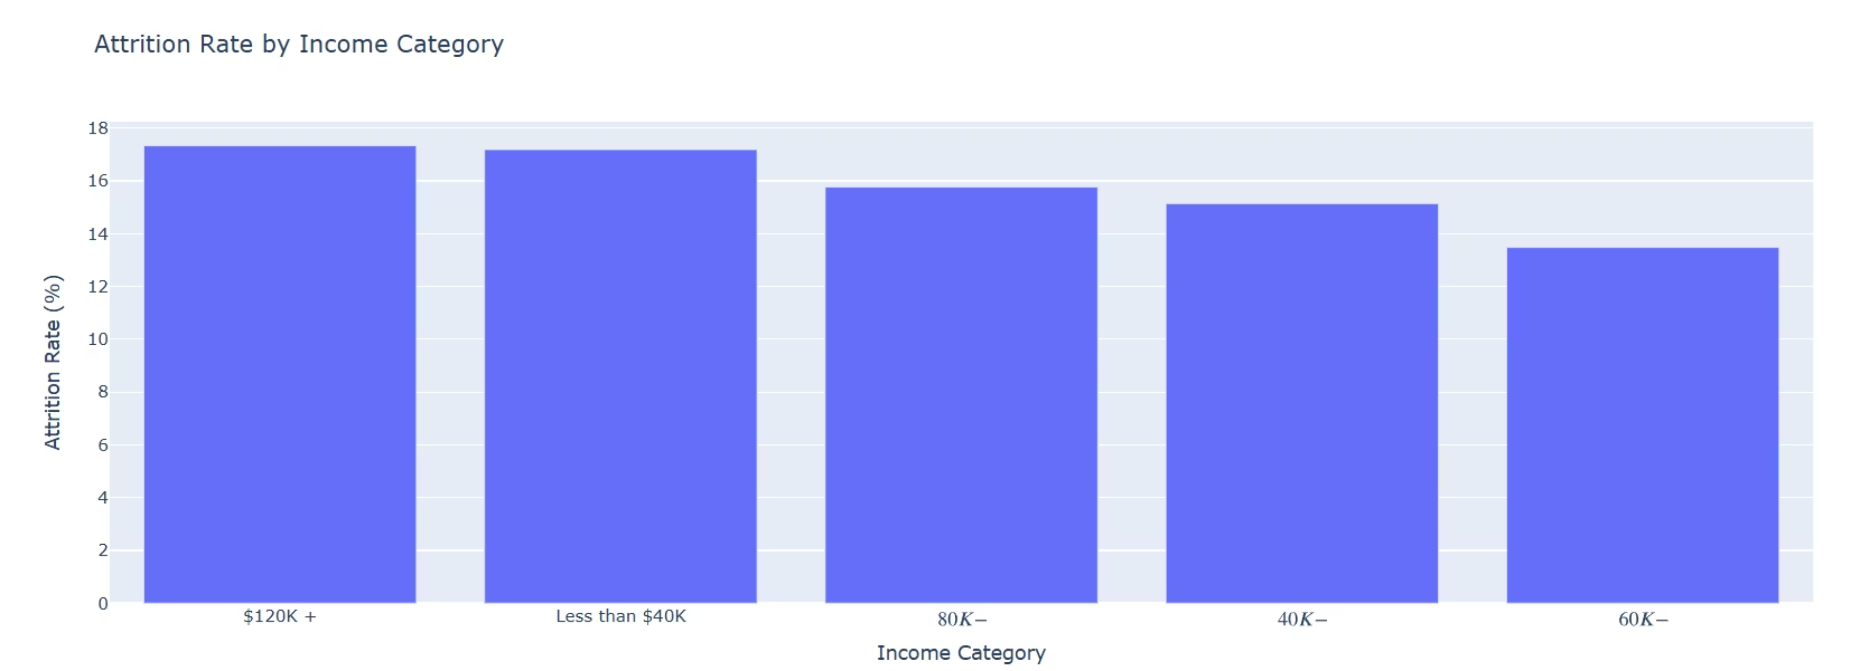
Q5: Income Category Impact on Churn
Critical Insight: Clear inverse correlation between income level and churn probability suggests price sensitivity and loyalty differences across economic segments. Low-income customers may be more responsive to fee structures and reward programs, while high-income customers demonstrate inherent loyalty to premium services.

Slide 10






Strategic Recommendations
Blue Card Loyalty Program
Deploy targeted benefits and rewards specifically designed for Blue cardholders to improve retention and engagement
Automated Inactivity Triggers
Implement system alerts that offer incentives when customer inactivity patterns increase beyond threshold levels
Senior-Targeted Retention
Develop specialized communication strategies and product offers tailored for customers in the 50+ age demographic
Low-Income Retention Bundle
Create affordable packages including fee waivers, micro-rewards, and tailored credit offers for price-sensitive segments
Predictive Churn Model
Build machine learning model using logistic regression or LightGBM for proactive customer outreach and intervention
Success Metrics: Track monthly attrition rate, retention campaign uplift, and customer lifetime value changes

